Slide 1
Kanban Method
By Tejaswini Kokane
(7670)Software Testing
11/15/2022

Slide 2
Kanban
Kanban is a very popular framework for development in the agile software development methodology.
Kanban is a workflow management method designed to help you visualize your work, maximize efficiency and be agile.
Kanban originally emerged from Japanese word that means, a card containing all the information needed to be done on the product at each stage along its path to completion.
It mainly uses physical and digital boards to allow the team members to visualize the current state of the project they are working on.
The Kanban board has columns and story cards.
Column means Workflow states, Cards shows the actual task of team member is performing.

Slide 3
Kanban
Kanban is a pull-based system, and cards are pulled from the previous stage to the current stages by team members.
Kanban method uses the Cumulative Flow Diagram (CFD )diagram to understand the team’s lead time and cycle time. This chart helps the teams to fix the gap between these two timings and improve efficiency.
Kanban development methodology, WIP limits the number of tasks/cards which can be worked on by a team member or entire at one time.
WIP limits shifts focus on getting things done as an individual focuses on a single task at a time.

Slide 4
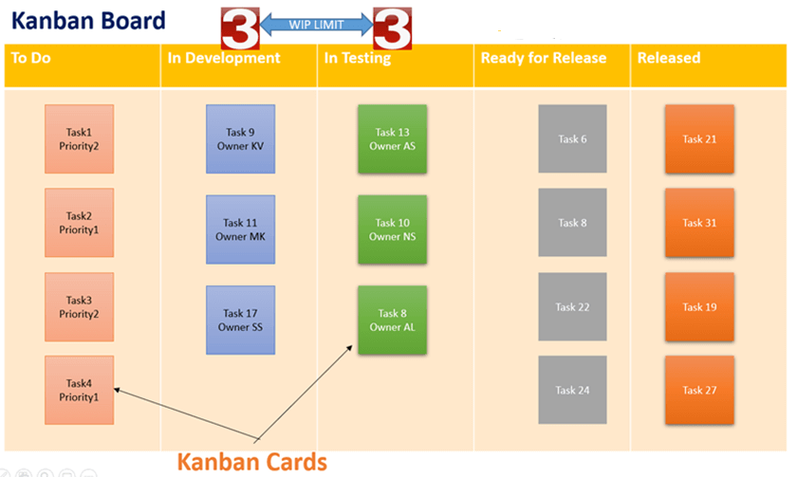
Kanban Card

Slide 5
Kanban Board
The Kanban cards are essential pieces on the Kanban board . These cards will have
Priority
Owner
Type
Due date
A column in Kanban board represents the work in progress(WIP).
The WIP limit means the maximum number of cards that can stay on that column.

Slide 6
Kanban Board
It has columns that represent the status of the work like
To-do,
Dev
Testing
Done.

Slide 7
Kanban Workflow
States | Understanding of tasks
To-do | Tasks arrive here for the first time in this state.
Ready for analysis | Analyze the task and add requirements completely.
Ready for development | Analysis completed and development can start.
In the development | Tasks are being developed.
Ready for testing | Development completed, and now testing can start.
In the testing | Tasks are being tested.
Ready for release | Testing completed; release can happen.
Released/Done | Released.

Slide 8
Difference Between Scrum and Kanban
Scrum | Kanban
In scrum technique, test must be broken down so that they can be completed within one sprint | No particular item size is prescribed
Prescribes a prioritized product backlog | Prioritization is optional
Scrum team commits to a particular amount of work for the iteration | Commitment is optional
Between each sprint, a scrum board is reset | A Kanban board is persistent. It limits the number of items in workflow state.
It cannot add items to ongoing iteration | It can add items whenever capacity is available
WIP limited indirectly | WIP limited directly
Time boxed iterations prescribed | Time boxed iterations optional

Slide 9
Thank You…!

